Slide 1
TATCC SOUTH
ATC BRIEF
G-BXBU CRASH
BY
FS NEIL MCDONALD

Slide 2
Background
Aircraft - Mudry Cap 10B (VFR only)
Departed Watchford Farm, Somerset at 0704 on 12 Aug 2021 with two POB
Met conditions good on departure
Intended to fly to Isles of Scilly for a day trip
Pilot described as ‘fair weather flyer’ and held no IFR qualification
Rarely spoke to ATC on radio

Slide 3
The Flight
G-BXBU flew SW as planned towards Cornwall
As it passed N of Culdrose it descended to 1000 feet over the sea
Turned right to head East away from planned destination
Flew over the sea at a minimum of 320 feet with a number of turns
Flew North climbing to 8200 feet

Slide 4
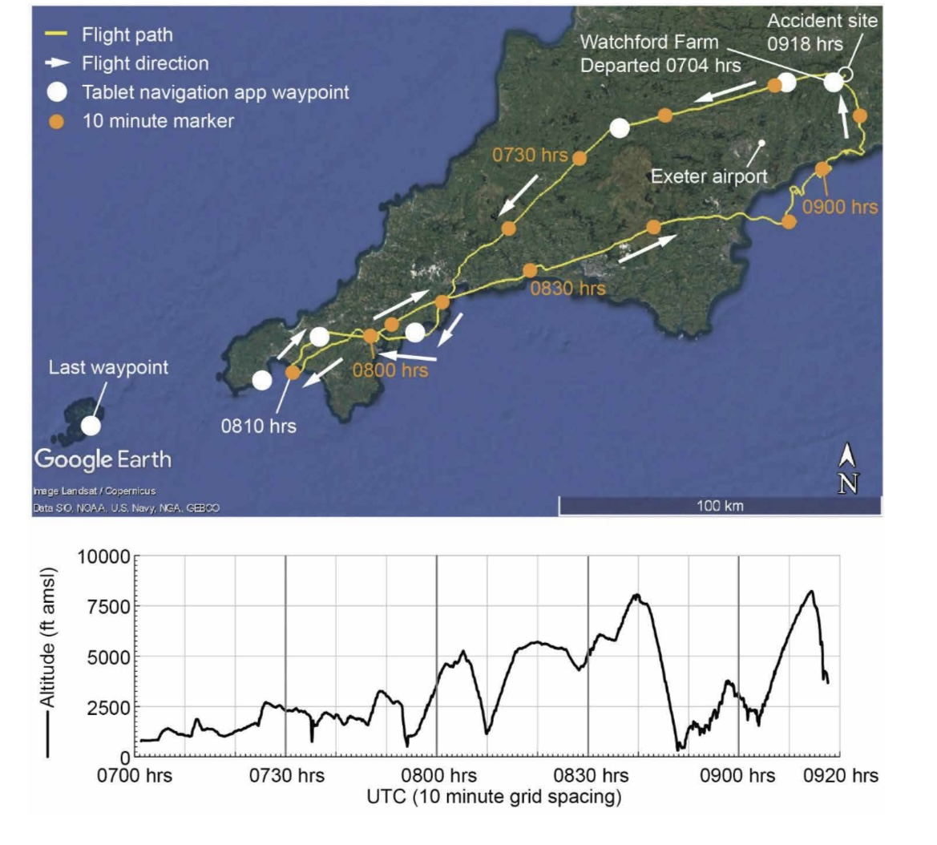

Slide 5
Weather Conditions
Weather deteriorated significantly
Last check by pilot 0519
Updates via TAF at 0600 forecasting the deterioration but only at Newquay
Other ATC unit weather forecasts showed poor weather as they became available as they opened
No means to get weather info
while airborne

Slide 6
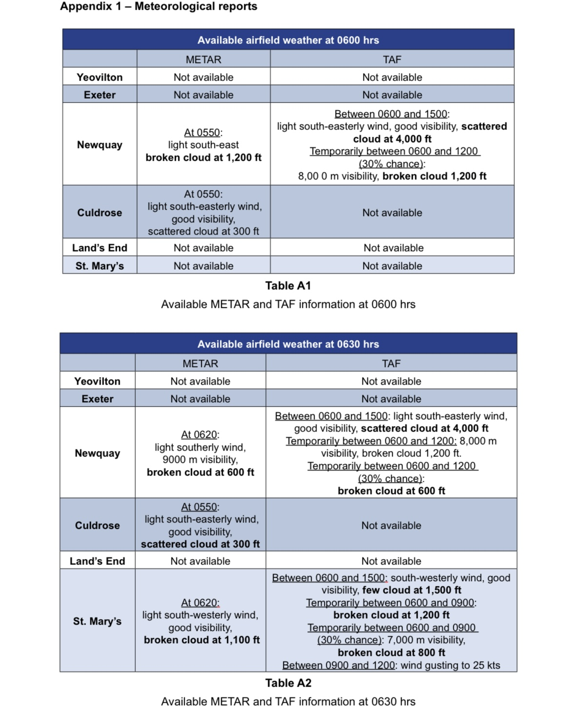
Local weather

Slide 7
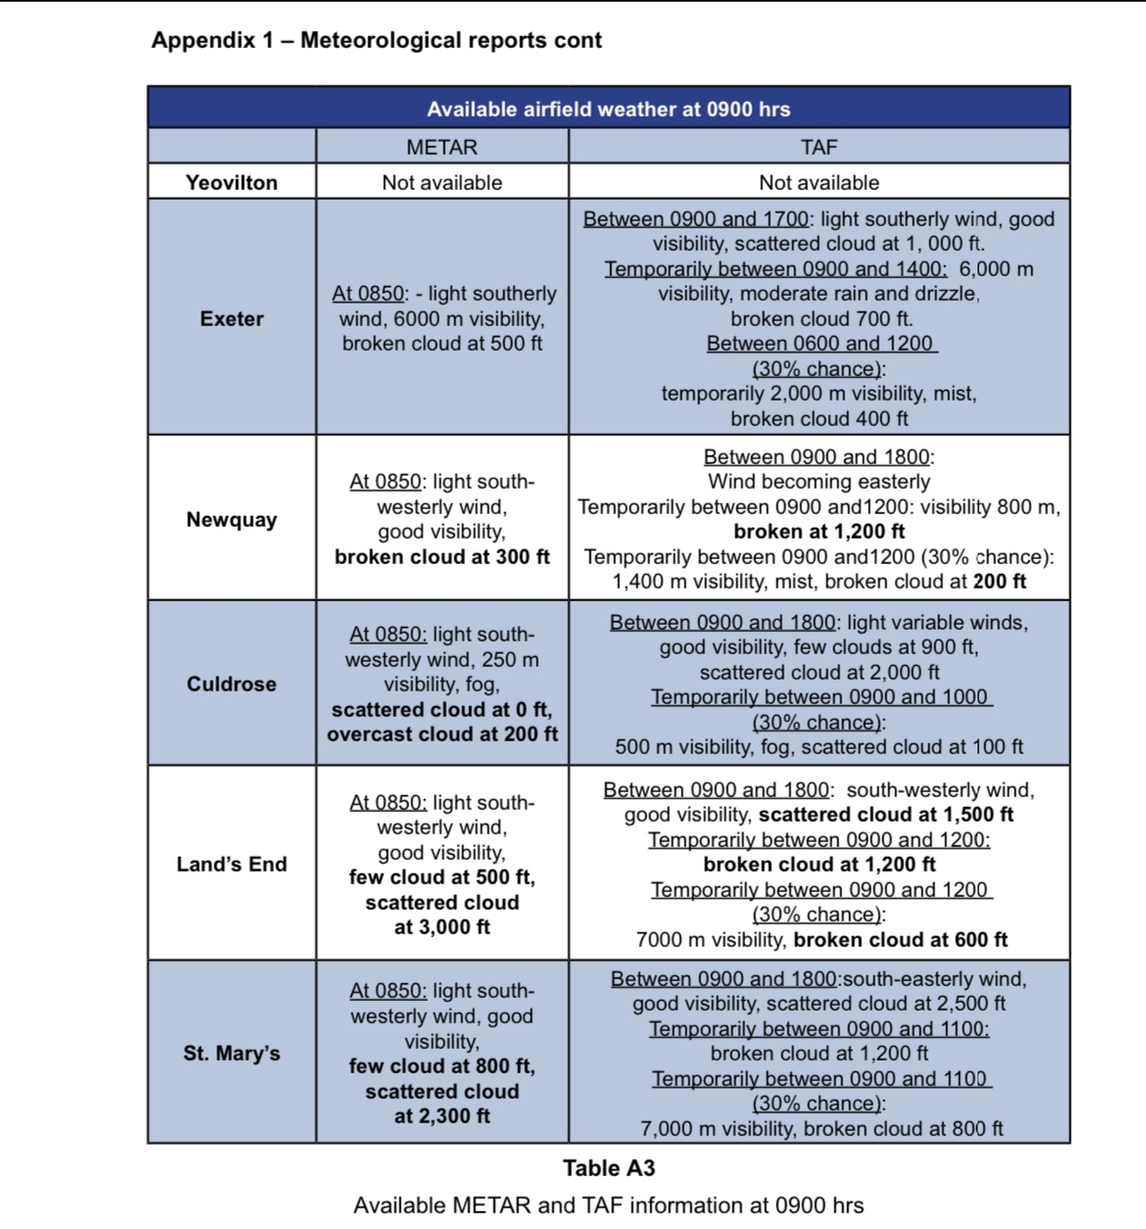
Local weather

Slide 8
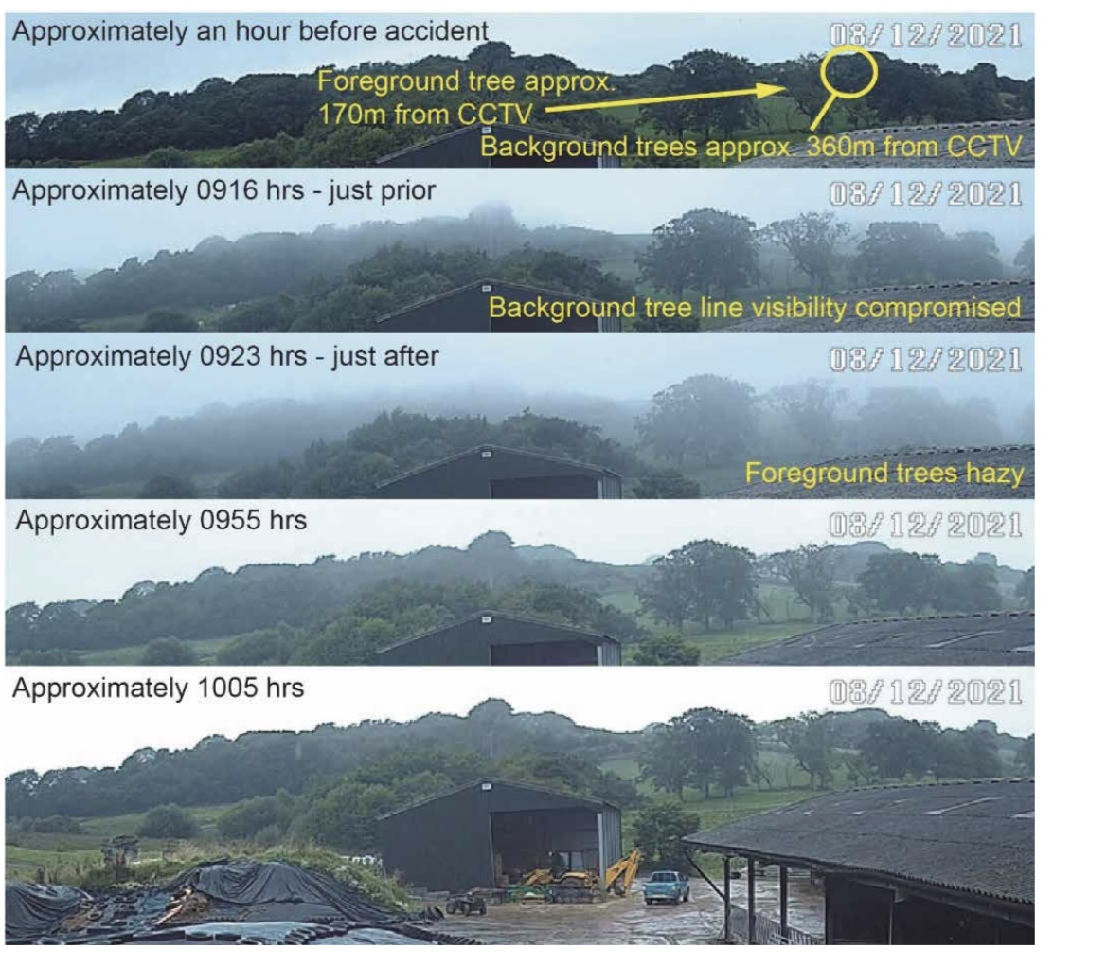
Weather at crash site

Slide 9
Emergency Declared
At approximately 0905 pilot called Dunkeswell Radio using the words “PAN, PAN, PAN”
His message asked about the weather conditions at the airfield and stating he couldn’t land at Watchford Farm because he was stuck above cloud.
Reply was that cloud base was
‘on the deck’ and vis 400m

Slide 10
Emergency Declared (cont)
Dunkeswell suggested Exeter radar or D&D on 121.5 MHz.
Pilot made another PAN call on 121.5 at 0911 stating he was in “real trouble” as he was stuck above thick cloud and didn’t know what to do
Finished transmission stating “I need to divert to somewhere close to
me where I can land”

Slide 11
D & D
D & D replied “your PAN is acknowledged
Pilot stated his altitude was 7500 feet and had fuel endurance of 1.5 hours
D & D asked pilot to squawk 7700 (pilot had transponder but it had not been switched on throughout the flight)

Slide 12
Exeter Airport
G-BXBU was flying in proximity to Exeter Airport
Exeter Airport were working Red 5 who had departed Exeter 28 minutes earlier and was holding with a technical issue
Exeter controllers had seen G-BXBU but with no altitude information due
to Transponder not being on

Slide 13
D & D speak to Exeter
Exeter had heard about G-BXBU on 121.5 and an Exeter assistant called D & D
D & D support answered
D & D support controller in this event provided support to D & D controllers equivalent to that provided by an ATC assistant
Transcript follows

Slide 14
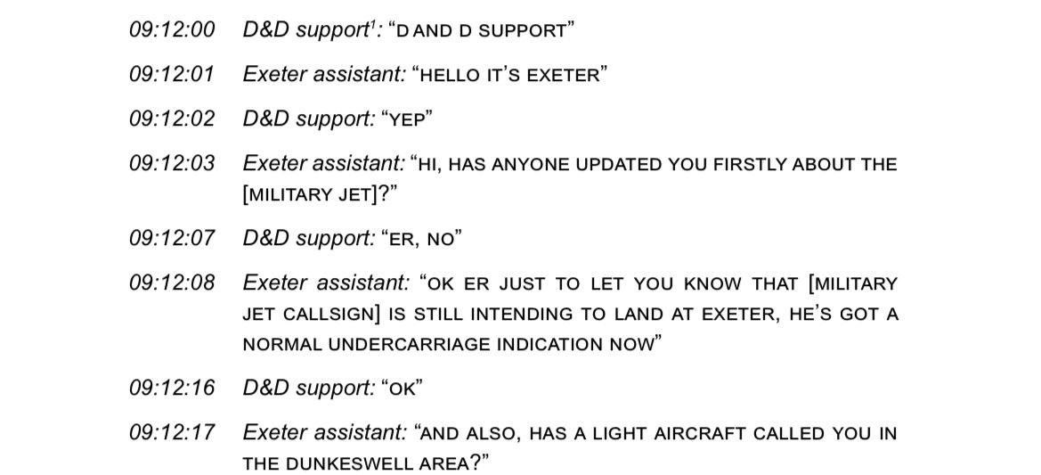

Slide 15
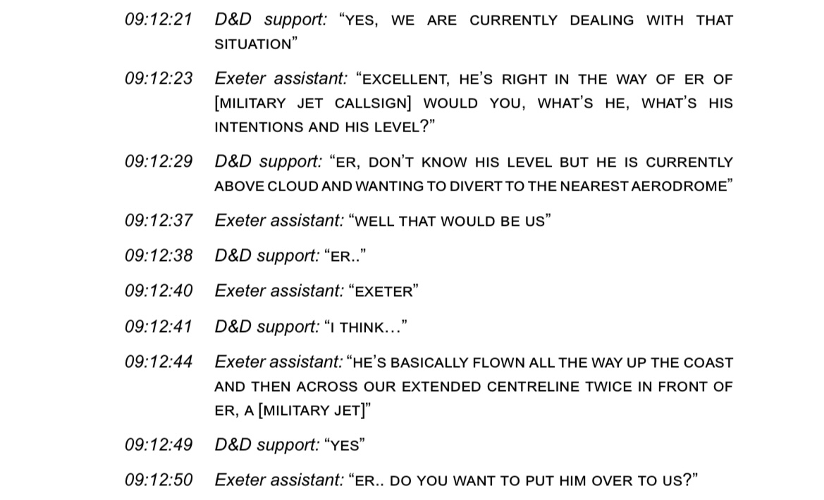

Slide 16
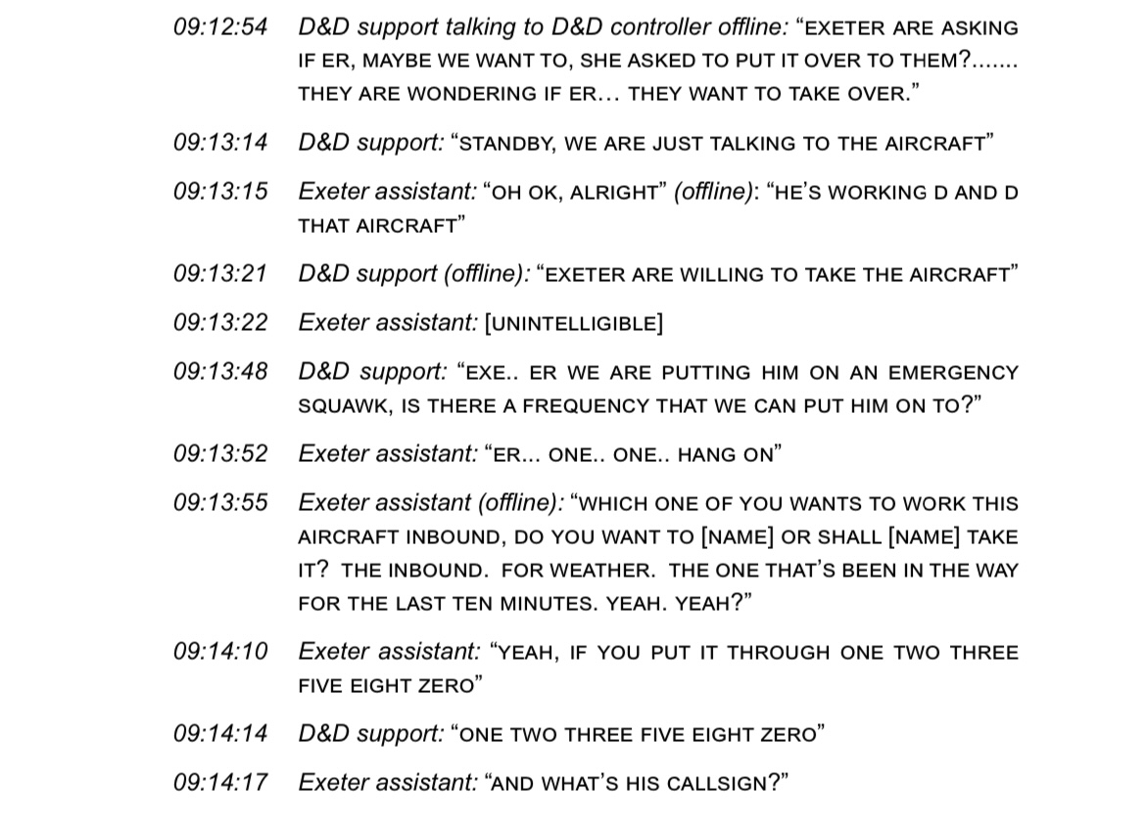

Slide 17
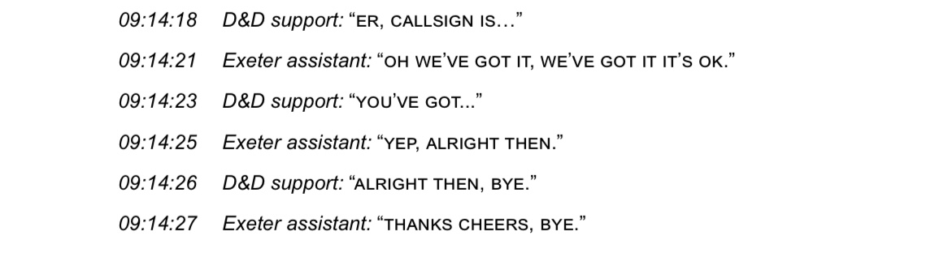

Slide 18
D & D Assumptions
D & D controller understood Exeter had been assessed as a suitable for a diversion by G-BXBU
He believed Exeter called soley to offer help to G-BXBU and not about Red 5
D & D controller could not hear the call between Exeter and D & D support controller

Slide 19
Exeter Assumptions
G-BXBU was DS therefore able to fly IFR / in IMC
G-BXBU was diverting as a PAN for weather and therefore was possibly fuel or time critical
G-BXBU would have been given the Exeter weather by D & D

Slide 20
G-BXBU with Exeter
Exeter controller initially sought to provide an ILS approach to G-BXBU
He replied that he couldn’t so vectors for SRA were given
Weather requested by pilot (a surprise to Exeter) and given as 6km visibility and cloud broken 500 feet
SRA procedure minimum 790 feet
ATC terminology confusing?

Slide 21
G-BXBU with Exeter
0914 controller observed the aircraft descending and not maintaining the assigned heading
0916 radar track showed the aircraft levelling briefly around 4000 feet
Instruction given to descend to 2600 feet which was minimum safe altitude

Slide 22
G-BXBU with Exeter
Last radio transmission from the pilot was “descending two thousand six hundred, you want me on two three zero?”
0917 last radar return showed the aircraft at 2700 feet
0920, Devon and Cornwall Police received a report of an aircraft accident. Both occupants were
fatally injured

Slide 23
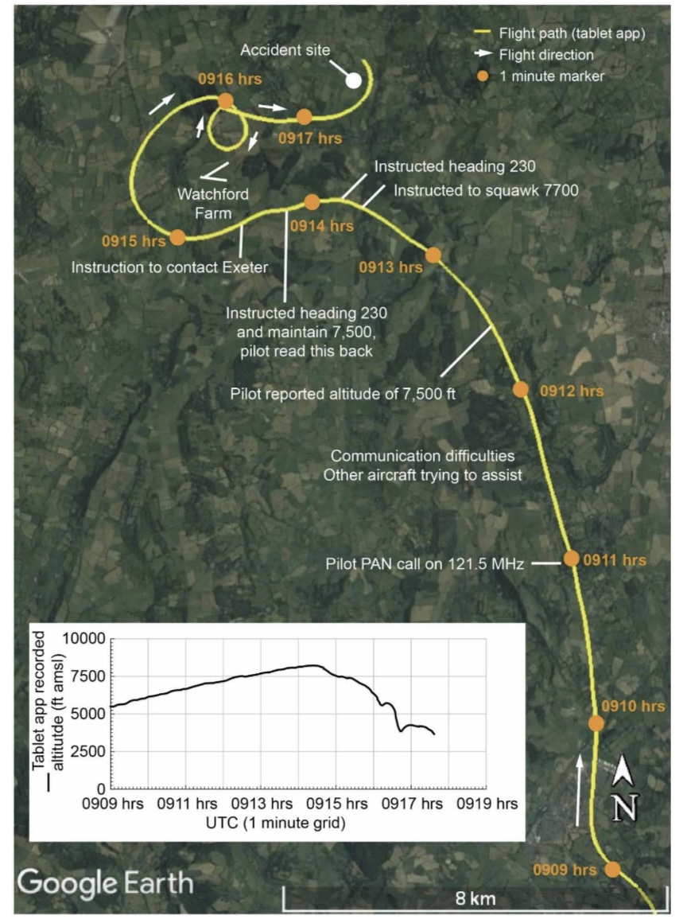
D and D comms

Slide 24
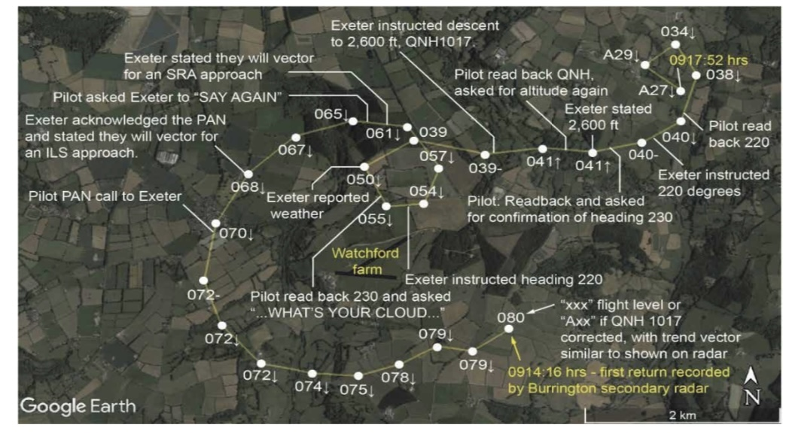

Slide 25
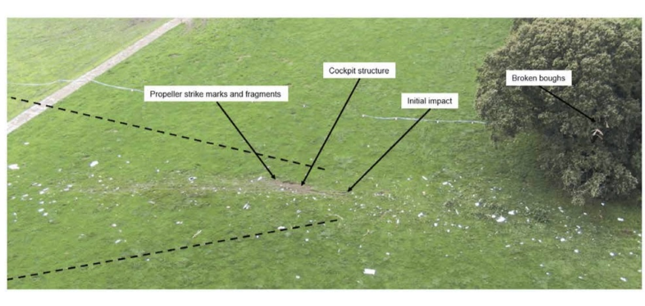
Crash Site

Slide 26
Lessons Identified Pilot POV?
Poorly briefed on weather
Unable to fly IFR or in IMC
Became mentally saturated after being stuck above cloud
Unsure of emergency procedures?
121.5 call only after being told
Panic set in after calling D&D and speaking to Exeter
Disorientated flying in cloud
Notes:
Sadly we will never know for sure hence the ?

Slide 27
Lessons Identified Controller POV
Lack of required information gleaned from pilot from D & D (eg VFR only)
Applied DS to aircraft despite inability to fly IFR/IMC
Pilot above cloud with 1.5 hours endurance so no immediate pressure to provide a solution
No consideration by D & D over what options were available
(Gloucester VFR within 1.5 hours)

Slide 28
Lessons Identified Controller POV
Radar handover was not between controllers
Lack of information given to Exeter controller prior to working G-BXBU
No check of Exeter weather conditions by D & D prior to handover
G-BXBU called a weather diversion multiple times by Exeter assistant
Assumption made could fly IFR
approach / in IMC as DS

Slide 29
Lessons Identified Controller POV
ILS offered first to G-BXBU despite limitations of aircraft
SRA offered despite procedure minimum being above the reported cloud base
No use of checklists
No understanding that pilot had reached cognitive saturation and was basically ‘a passenger’ therefore
didn’t question instructions

Slide 30
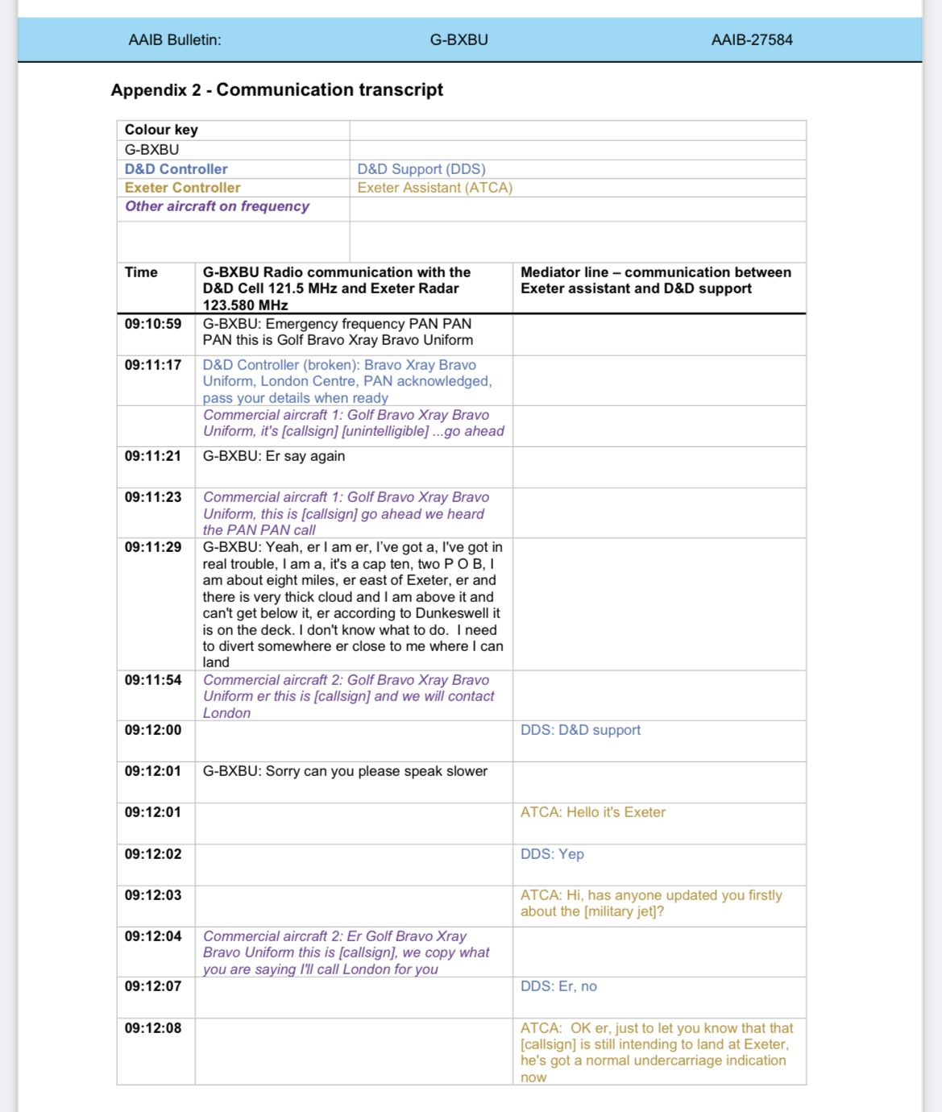

Slide 31
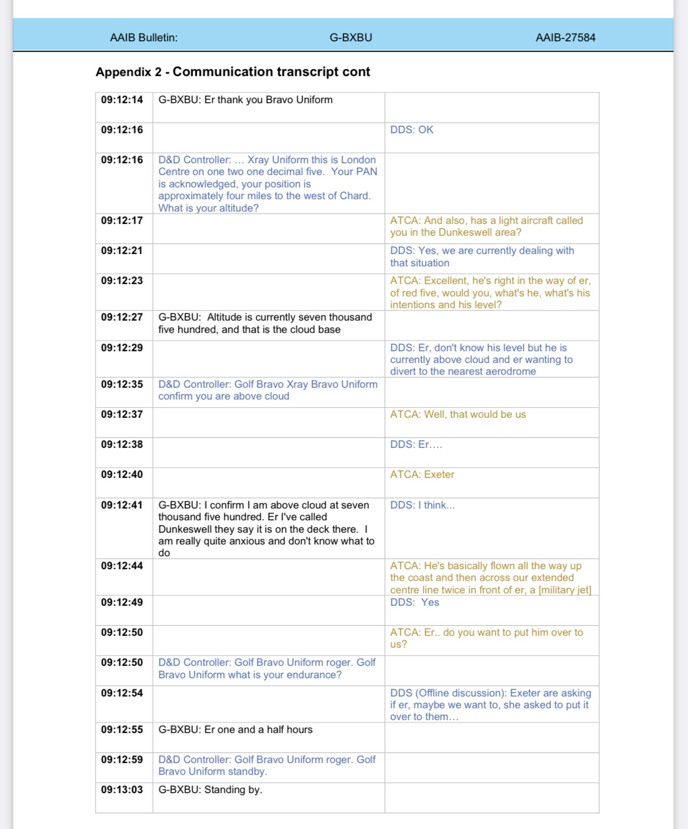

Slide 32
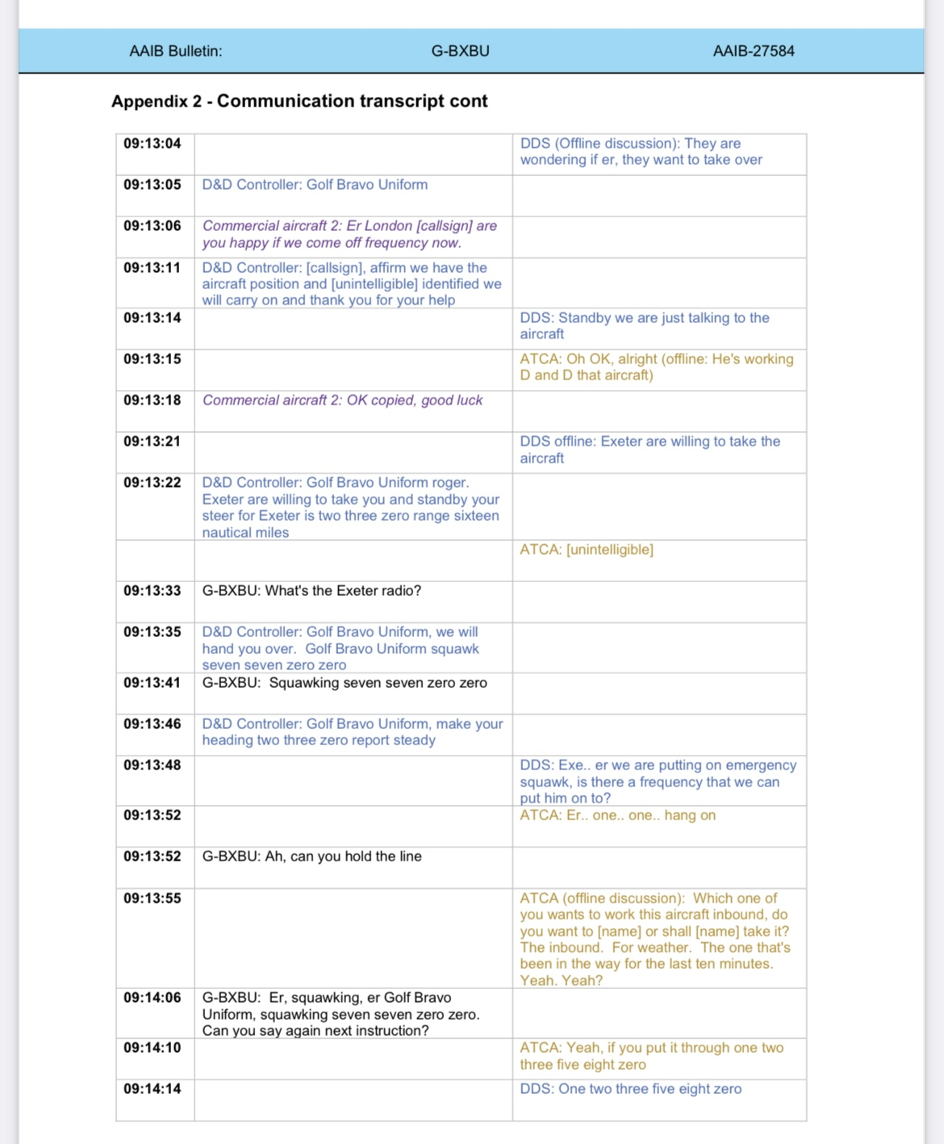

Slide 33
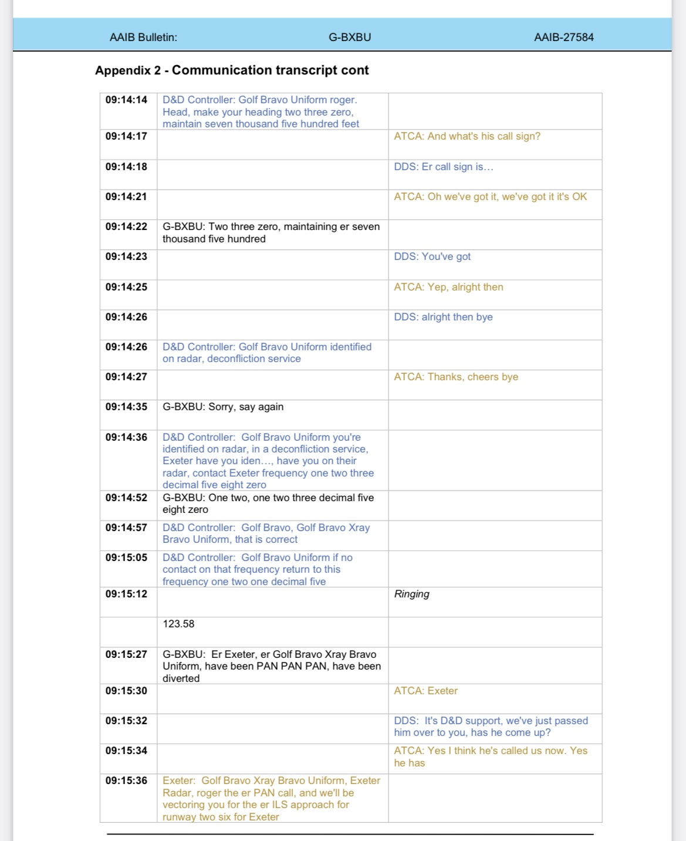

Slide 34
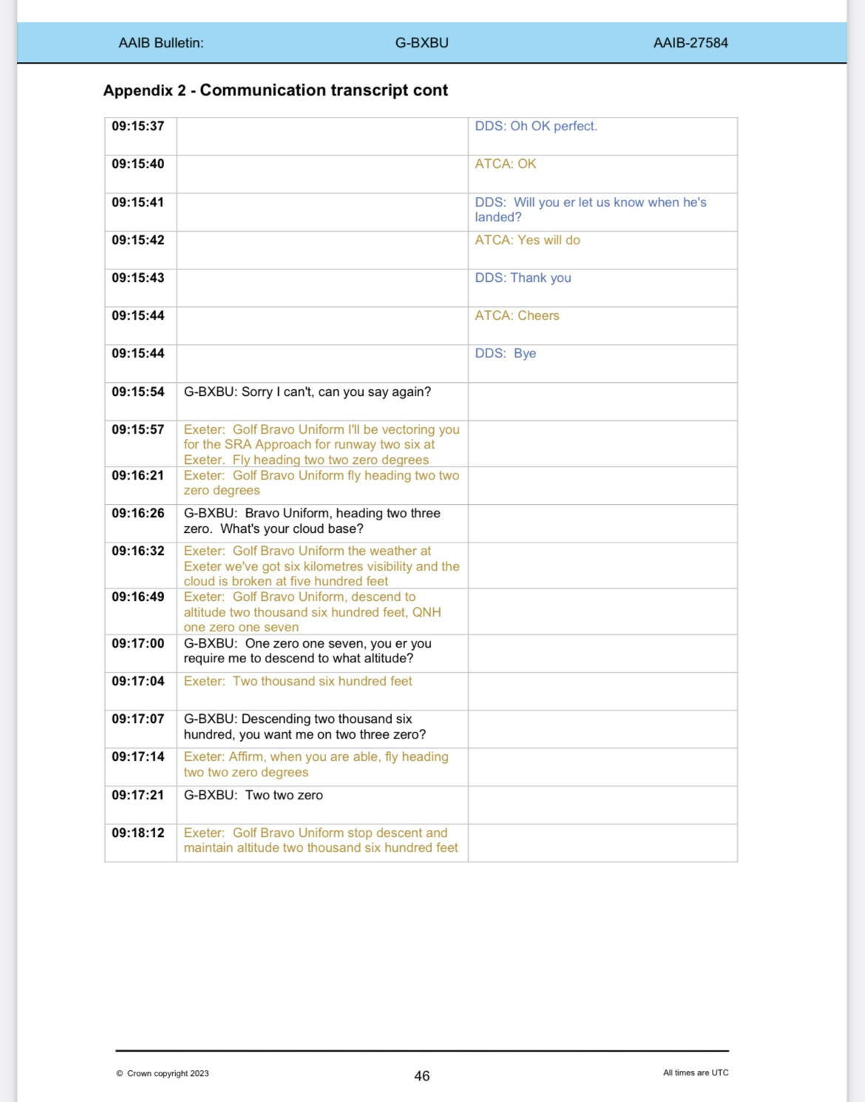

Slide 35
Cognitive saturation/overload
Cognitive overload defined as:
A state of mental exhaustion that occurs when the demands placed on working memory exceed its capacity
Notes:
Clearly the tape transcript shows the pilot had reached this stage.

Slide 36
Cognitive saturation/overload
Effects of Cognitive overload:
Decreased productivity
Burnout
Poor decision making

Slide 37
Cognitive saturation/overload
What does Cognitive overload look like?
Difficulty concentrating
Forgetfulness
Feeling overwhelmed or anxious

Slide 38
Cognitive saturation/overload
Overcoming Cognitive overload:
Prioritising and simplifying tasks
Allowing for regular breaks (no rush in this instance 1.5 hours endurance)
Break down instructions into smaller and simpler pieces
Use simple terminology (Not ILS)

Slide 39
Lessons Identified Controller POV
MATS PART 1 STATES
Controllers shall offer as much assistance as possible to any aircraft that is considered to be in an emergency situation
Notes:
Did they?

Slide 40
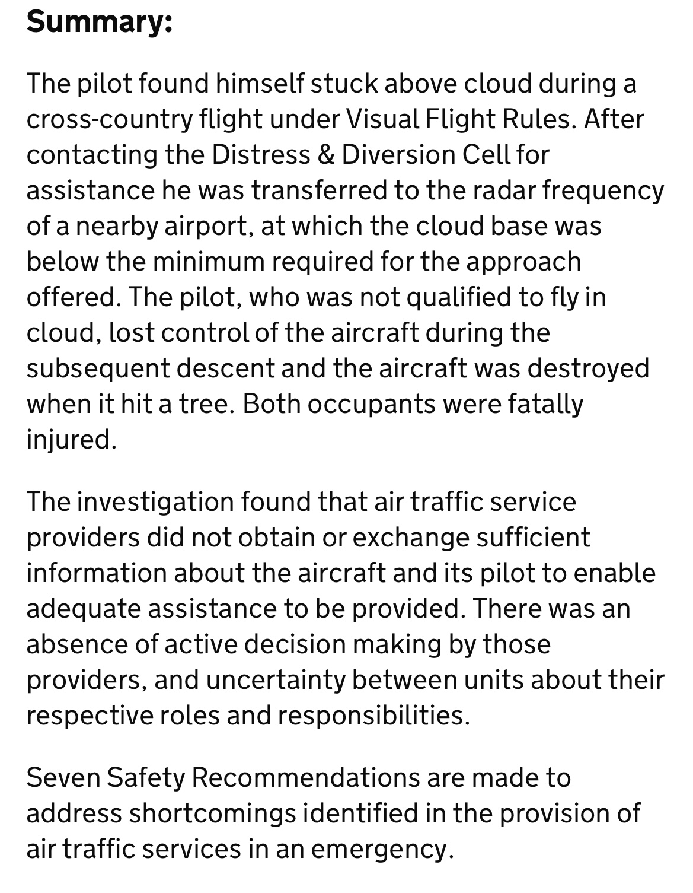
Conclusion

Slide 41
Link to full report with
Safety Recommendations
Mudry_Cap_10B_G-BXBU_06-23.pdf (publishing.service.gov.uk)

